Slide 1
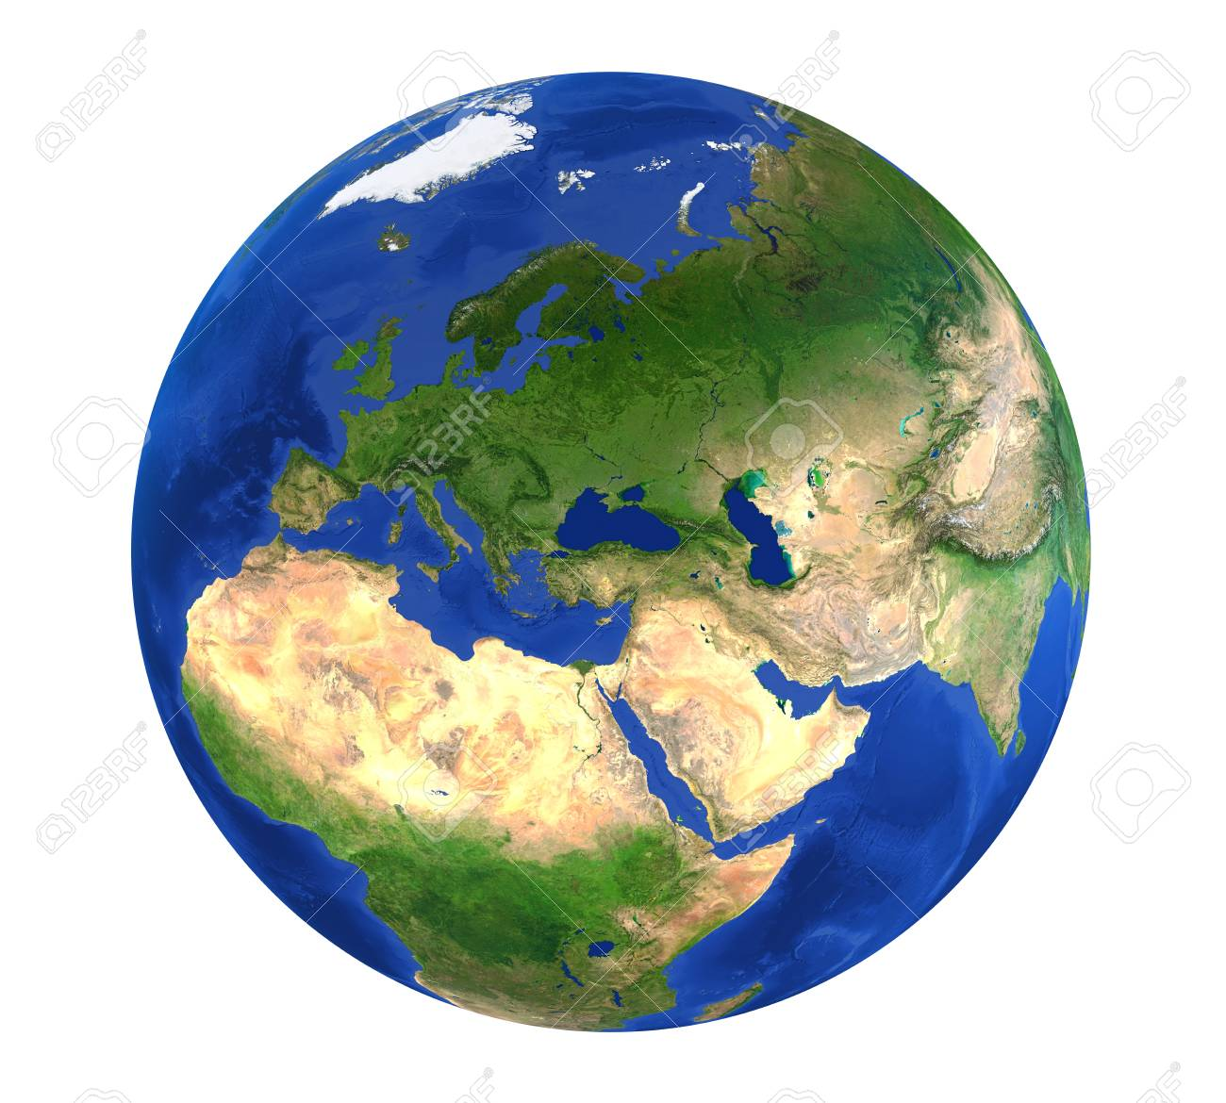
Some of our country projects.
I hope you like facts, because you are about to learn loads of them!

Slide 2
Check out the next 3 pages for information on Austria! This student has done some much research, also I have to comment on how neatly presented the project is ☺

Slide 5
Such a cool way to present information. This student has drawn flag excellently and has done their writing in the same colours as the flag which is a really nice touch ☺

Slide 6
Be prepared to learn loads!

Slide 8
Wow! It is clear this student has done a lot of research on Saudi Arabia! I learned some much from reading this project ☺ this project.

Slide 9
We actually study Japan in November. This student has a really great memory and has done loads of extra research. The map of Japan is excellent.

Slide 11
A very interesting choice of country. This student has used some fantastic vocabulary and created a very detailed flag ☺

